Slide 1
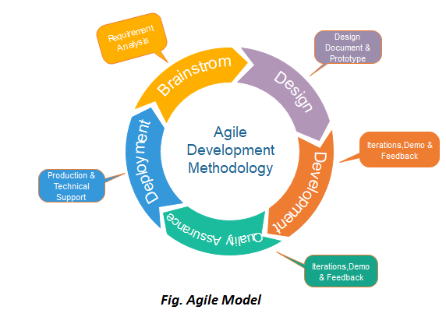
Agile Model
The meaning of Agile is swift or versatile . "Agile process model“ refers to a software development approach based on iterative development. The agile methods were developed to overcome the weakness of conventional software engineering. Agile methods break tasks into smaller iterations, or parts do not directly involve long term planning.

Slide 2
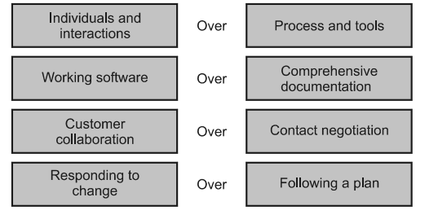
Agile Manifesto
The Agile Manifesto, also called the Manifesto for Agile Software Development, is a formal declaration of four key values and 12 principles to guide an iterative and people-centric approach to software development.

Slide 3
Agile Principles
There are famous 12 principles used as agility principles –
Satisfy the customer by early and continuous delivery of valuable software.
2. The changes in the requirements must be accommodated. Even though the changes occur late in the software development process, the agile process should help to accommodate them.
3. Deliver working software quite often. Within the shorter time span deliver the working unit.
4. Business people and developers must work together throughput the project.
5. Motivate the people who are building the projects. Provide the environment and support to the development team and trust them for the job to be done.
6. The working software is the primary measure of the progress of the software development.

Slide 4
Agile Principles
7. The agile software development approach promote the constant project development. The constant speed for the development of the product must be maintained.
8. To enhance the agility there should be continuous technical excellence
9. The proper attention to be given to technical excellence and good design.
10. The simplicity must be maintained while developing the project using this approach.
11. The teams must be the self-organizing team for getting best architecture, requirements and design.
12. At regular intervals the team thinks over the issue of becoming effective. After the careful review the team members adjusts their behavior accordingly.

